Slide 1
EENG 284 - Lab 8 Control + Datapath + RAM

Slide 2
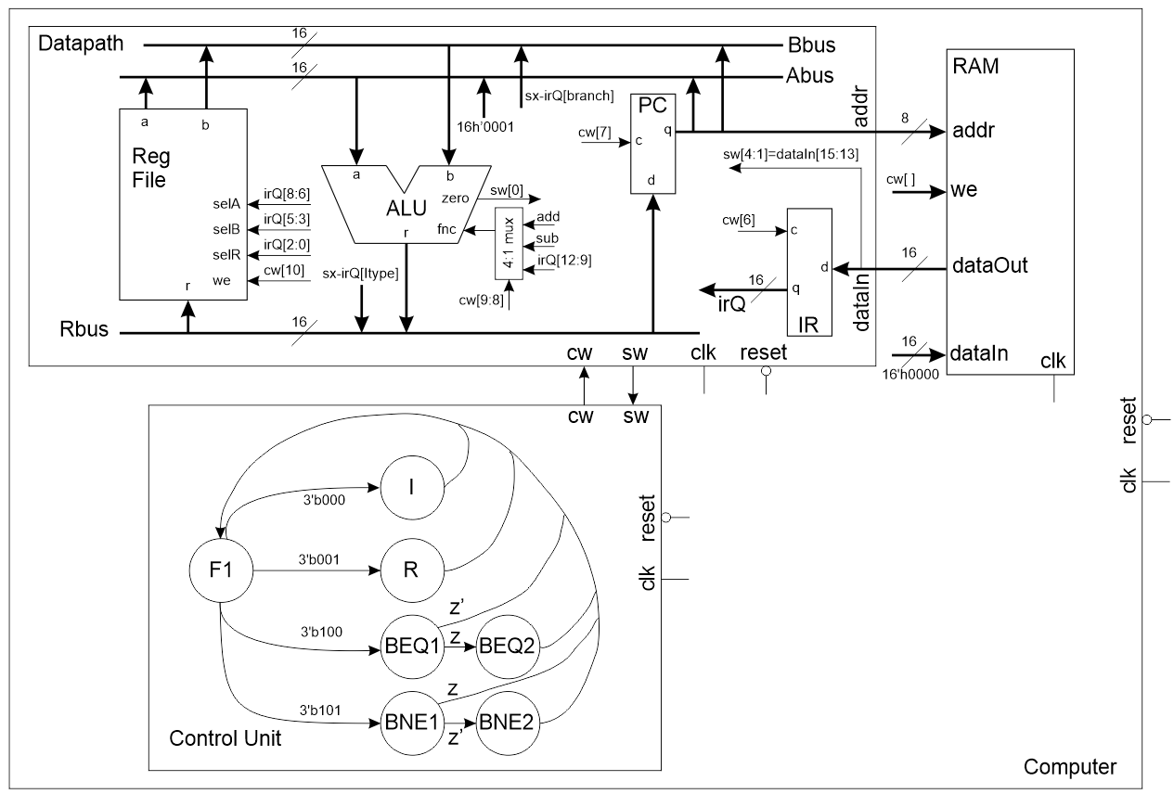
Control + Datapath + RAM
Instructions automatically fetched from RAM into IR
Executed conditionally based on their opcode
Include branch instructions

Slide 3
Instructions
BEQ
if (RS1 == RS2) PC = PC + IR
else PC = PC + 1
Offset = (source + 1) - target
 | 15 | 14 | 13 | 12 | 11 | 10 | 9 | 8 | 7 | 6 | 5 | 4 | 3 | 2 | 1 | 0
I | 0 | 0 | 0 | x | x | Immediate |  |  |  |  |  |  |  | Dest
R | 0 | 0 | 1 | fnc |  |  |  | selA |  |  | selB |  |  | selR
BEQ | 1 | 0 | 0 | Offset MS |  |  |  | sel A |  |  | sel B |  |  | Offset – LS
BNE | 1 | 0 | 1 | Offset – MS |  |  |  | sel A |  |  | sel B |  |  | Offset – LS

Slide 4
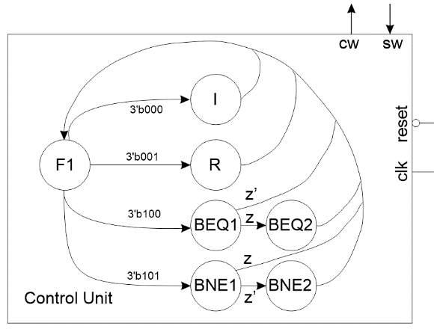
The Control Unit
module controlUnit(clk, reset, cw, sw);
11 bit control word
4 bit status word
Look up trafficLightController on Canvas File -> Verilog -> trafficLight

Slide 5
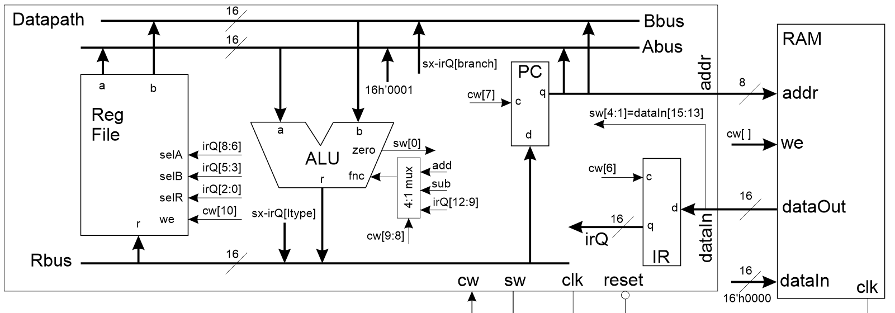
The Datapath
Change PC to register
Add 4:1 muxes to A, B and R bus
Add 4:1 mux for ALU select
sw[3:1] uses datain for opcode NOT irQ output!

Slide 6
The Control Word
11 bits, output from control unit and input to datapath
Make sure to get the order of your mux inputs correct!
module genericMux4x1(y3, y2, y1, y0, sel, f);
You may not use all select combinations – next week.
 | 10 | 9,8 | 7 | 6 | 5,4 | 3,2 | 1,0
Code | RF WE | ALU | PC | IR | ABUS | BBUS | RBUS
00 or 0 | Hold | IR[12:9] | Hold | Hold | RFa | RFb | MBR
01 |  |  |  |  | 16’h0001
10 |  | Sub |  |  |  | IR[BR] | IR[IMM]
11 or 1 | Write | Add | Load | Load | PC | PC | ALU

Slide 7
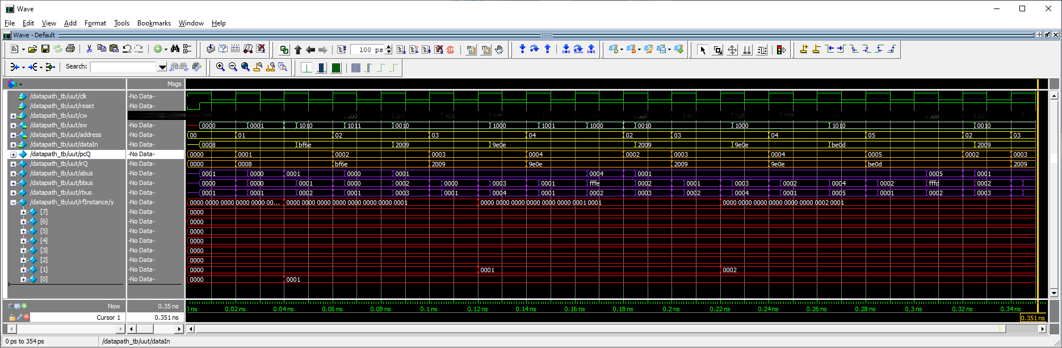
Deliverables
Control testbench
Datapath testbench
Computer testbench

